Slide 1

Ministry of Health
Kenya Chemosafe Program 2018

Slide 2
Cancer Landscape in Kenya

Slide 3
Outline
Cancer Burden
Components of cancer control
National Cancer Control Framework
National Cancer Control Strategy
National Cancer Screening Guidelines

Slide 4
Cancer Statistics

Slide 5
Cancer Statistics

Slide 6
Cancer in Kenya
3rd leading cause of death in Kenya, after infectious diseases and cardiovascular diseases
2018: 47,887 new cases; 32,987 deaths (GLOBOCAN, 2018)
New cases: males 19,199, females 28,688, 0-19 years – 3,272 (GLOBOCAN, 2018)
45% increase in incidence from 2012

Slide 7
Cancer Statistics

Slide 8
Cancer Statistics

Slide 9
Cancer Statistics

Slide 10
Cancer Statistics

Slide 11
Cancer Statistics

Slide 12
Incident cases and deaths in Kenya

Slide 13
Components of Cancer Control
Primary prevention
Early detection and Diagnosis
Treatment
Palliative care
Cancer surveillance and research
Coordination of cancer prevention and control
Monitoring and Evaluation

Slide 14
Primary Prevention
Tobacco use
Alcohol
Overweight and obesity
Healthy diet
HPV Vaccination

Slide 15
Current Tobacco Use
Kenya STEPS Survey 2015

Slide 16
Current Alcohol Drinkers
Kenya STEPS Survey 2015

Slide 17
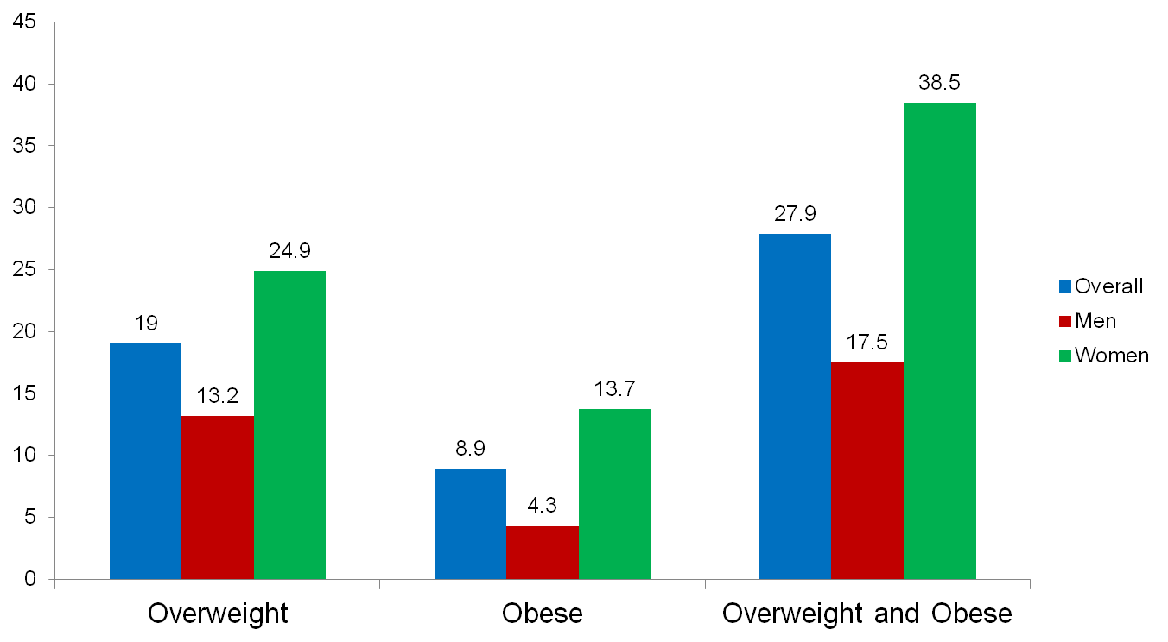
Prevalence of Overweight and Obesity
Kenya STEPS Survey 2015

Slide 18
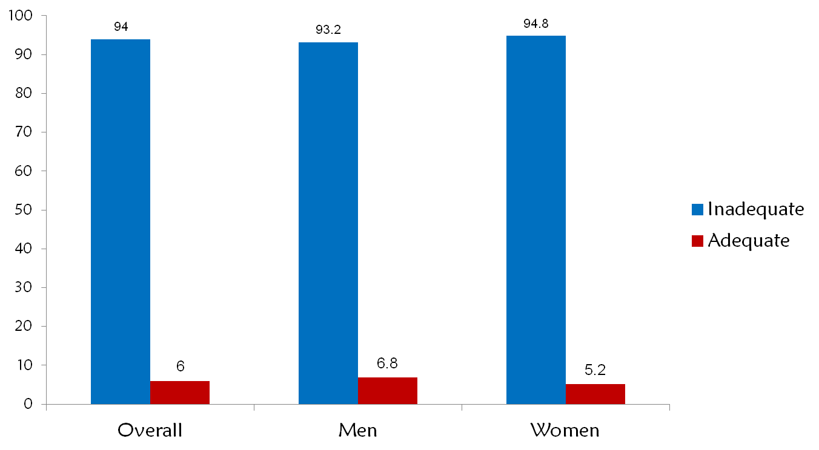
Low consumption of fruits and vegetables
Kenya STEPS Survey 2015

Slide 19
HPV Vaccination
1st demonstration project 2013-2015
Target group - 21,000 girls in class 4
Approach - school health program; provided by nearest health provider
Coverage – 85%
Cost per fully immunized girl- Financial USD 20; Economic costs USD 40
National scale up- 2018/2019: National roll-out for 10 year old girls starting in 2019

Slide 20
Early Detection
Proportion of women screened for cervical cancer
Overall screening- 11.3%
Kenya STEPS 2015

Slide 21
Early Detection - KDHS 2014
10% of women had both a self-breast exam and clinical breast exam by health worker
76% ever heard of cervical cancer
14% have had a cervical cancer screening exam
65% of men have heard of prostate cancer
3% ever examined by a doctor or health care provider for prostate cancer

Slide 22
Diagnosis and Treatment
Diagnosis
Pathology services are inadequate and unevenly distributed towards the private sector
MoH MES project for diagnostic imaging (mammography)
PET CT available in AKUH
Surgery
Available at national and county referral hospitals, partially covered by NHIF
Radiotherapy
6 facilities in Nairobi providing radiotherapy (5-private; 1-public), 4 centres in Nairobi providing brachytherapy
Eldoret – Procurement of equipment ongoing in MTRH, radiotherapy and brachytherapy available in a private facility
Bunker construction underway in 3 regional centres (Msa, Nku, Garissa)
Included in the NHIF benefit package (Ksh. 18,000/- per week for external beam; Ksh 80,000 for brachytherapy)
Chemotherapy
GoK supporting establishment of 10 regional chemotherapy centres

Slide 23
Diagnosis and Treatment (2)
Human resource development
MMED Pathology programmes
Medical oncology programmes- Nairobi University (Sept 2016); Moi (2017)
Gynae-oncology fellowship- Moi University (Ongoing)
Radio-oncology curriculum- starting in Sept 2019 in UoN
Oncology Nursing training programmes- HND, MSc
Training for Clinical Officers - HND in Moi University
Training of Radiotherapy technologists - Diploma (KMTC), JKUAT

Slide 24
Diagnosis and Treatment (3)
Evidence-based practice guidelines
National Cancer Management Guidelines 2013 disseminated and in use
National Cancer Control Strategy 2017-2022, launched in July 2017
National cancer screening guidelines launched in Feb 2019, dissemination ongoing
Guidelines for establishment of cancer centres finalized by MOH/NCI, awaiting launch
National cancer management protocols to be finalized by June 2019
Palliative & end-of-life policy currently under development
IEC materials for healthcare workers and patients developed by MoH, ACS and KENCO

Slide 25
Human Resource Capacity
 | Available but no. increasing
Medical Oncologists | 15
Radiation oncologists | 20
Paediatric oncologists | 4
Oncology Nurses | 20
Radiation therapists | 27
Medical Physicists | 11
Nuclear physician | 1
Nuclear technologists | 3
Oncology Pharmacists | 10
Clinical Officers in Oncology | 43
Limited oncology capacity in the country
Services only available in urban centres, primarily Nairobi and Eldoret, affecting access and cost specialized services
Opportunity for health workers to pursue specialization in oncology

Slide 26
Universal Health Coverage (UHC) and Cancer Management
The UHC program is one of the Government’s Big Four Agenda for economic development. Focus of UHC is to increase access to quality essential health services for all.
Cancer management activities under the UHC program include:
Access to specialized care – MoH has prioritized specialized cancer care as critical to attaining universal access for cancer management through expansion of cancer management infrastructure across the country.
Awareness Creation - Cancer management activities have been incorporated in UHC program activities through training on Community Health Volunteers (CHVs) on cancer prevention and promotion messages in UHC pilot counties in order to increase cancer awareness in the country.

Slide 27
Palliative Care
Most of patients present or are diagnosed in late stage of disease and are treated on a palliative basis
National Palliative Care Guidelines 2013
Palliative care services available in 42 public county hospitals
11 faith-based and private hospitals provide palliative care
17 hospices in operation; 2 with in-patient capacity
Morphine included in the KEML; initiatives to include other supplies in KEMSA
Palliative care training integrated in undergraduate community health, nursing and medical curricula

Slide 28
Cancer Surveillance and Research
Three existing Population Based Cancer Registries; Several Hospital Based Cancer Registries
Establishment of the National Cancer Registry ongoing
Reporting currently through DHIS
Limited use of existing data from the registries
Paper-based and under-reporting
Need to have dedicated HRIOs for cancer registries (Cancer registrars)

Slide 29
Policy Environment in Kenya
Legislation
Tobacco Control Act 2007
Alcoholic Beverages Control Act 2010
Cancer Control Act 2012
Policy
Kenya National Strategy for the Prevention and Control of NCDs 2015-2020
National Cancer Control Strategy (2017-2022)
National Cancer Management Guidelines 2013
National Cancer Screening Guidelines
National Cancer Management Protocols
QA guidelines for specimen handling – under development

Slide 30
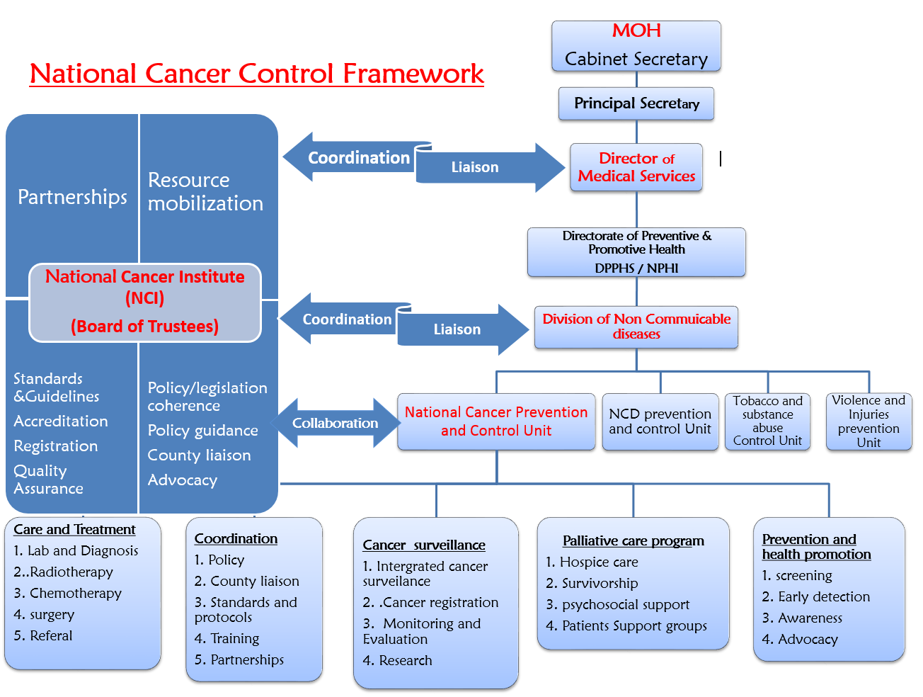

Slide 31
Coordination- National Cancer Institute of Kenya
Established under the Cancer Control Act (No. 15) of 2012
Multi-sectoral membership
Government agencies- MOH, National Treasury, AG’s office
Civil Society
Media owners association
Philanthropist
Academia
Research organizations

Slide 32
NCI Kenya Mandate
Advise the Cabinet Secretary on matters related to cancer treatment
Oversee establishment of cancer management centers in the country
Ensure coordination of treatment services, psycho-social and community support of cancer patients
Oversee development of information and education material on cancer
Monitor collection, analysis and dissemination of cancer registration data;

Slide 33
NCI Kenya Mandate
Provide for coordination, documentation and sharing of international and local cancer research efforts;
Establish mechanisms for access to affordable, safely administered cancer medicines, biological materials and other therapeutic substances
Ensure environmental causes and aggravations of cancer are addressed;
Ensure access to accredited vocation training in cancer prevention and treatment
Share information on cancer prevention and control

Slide 34
PILLARS
M&E Research
Prevention, early detection and screening
Diagnosis, registration &surveillance
Coordination, partnership &financing
Treatment, palliative care & survivorship

Slide 35
Priority Interventions (1)
Prevention
Promote healthy lifestyle
Reduce environmental and occupational exposure
Screening
Increased access to cancer screening services
National screening programme for priority cancers
Early detection
Programs for prompt diagnosis of symptomatic patients/down-staging of cancers
Appropriate referral
Vaccination – HPV, HBV, HCV

Slide 36
Priority Interventions (2)
Diagnosis
High quality tiered diagnostic network with specialized referral centres
Focus on both laboratory and medical imaging diagnostic techniques
Registration& surveillance
Establishment of national population based registry
Operational research
Treatment & survivorship
Equitable access to comprehensive cancer treatment services
Improved infrastructure for treatment
Focus on support services

Slide 37
Priority Interventions (3)
Palliative care
Integration of palliative care into existing health services
Strong community involvement
Coordination & partnerships
NCCP and NCI-K responsible for cancer control in Kenya
Strengthen existing partnerships
Financing
Sustainable financing – Cancer fund , Exchequer
Universal coverage for cancer care- Enhanced role of NHIF
Public Private Partnerships
Improved coordination

Slide 38
Challenges
Low awareness about cancer- low screening uptake
Inadequate specialized personnel- numbers, skills
Low capacity to carry out cancer diagnosis
Inadequate treatment infrastructure
Poor documentation- demographic and medical information missing/ not recorded in the patient’s notes; low registration rates
Limited funding to cancer prevention and control

Slide 39
Call for Action
High index of suspicion for cancer
Appropriate awareness creation on cancer
Timely referrals for patients
Documentation of data & reporting
Advocacy in all aspects of cancer
Encourage NHIF enrollment by patients and the public

Slide 40


